Slide 1
Order Process

Slide 2
On placing an order
Mailer: Slide 3
My Account: Status as ‘Placed’

Slide 3
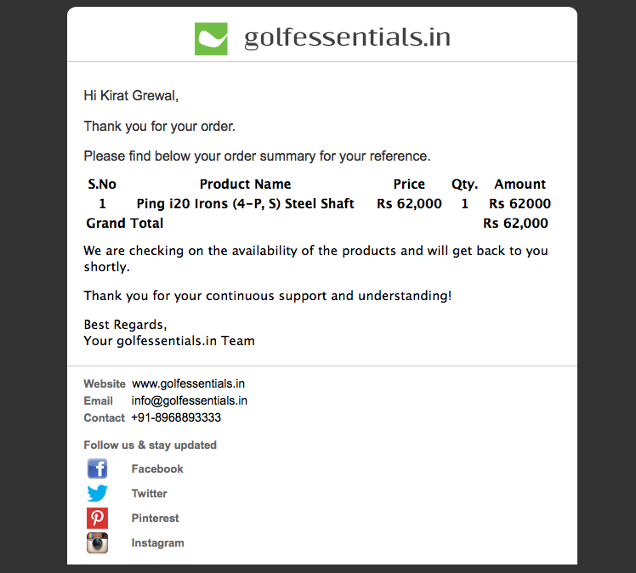

Slide 4
If the products are in stock (for all orders except COD)
Mailer: Slide 5
My Account: Status as ‘Confirmed: Awaiting payment’

Slide 5
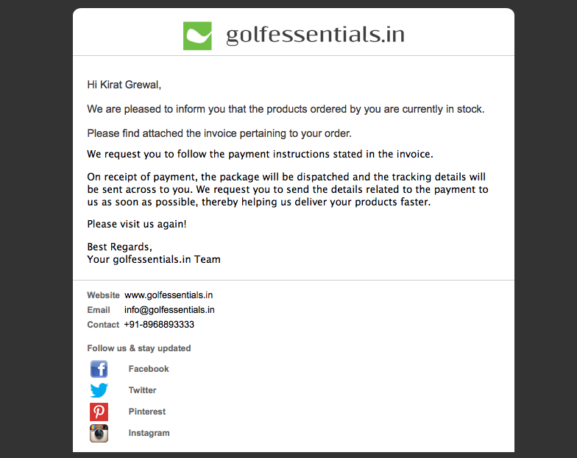
the delivery status will be updated in ‘Orders’ under ‘My Account’ (My Account should be linked)

Slide 6
If some of the products are in stock (for all orders except COD)
Mailer to be sent after a phone call: Slide 7
My Account: Status as ‘Confirmed: Awaiting payment’

Slide 7
the delivery status will be updated in ‘Orders’ under ‘My Account’ (My Account should be linked)

Slide 8
If none of the products are available
Phone call informing the user. Option given to the user to be notified when the product is in stock.
My Account: Status as ‘Currently out of stock’

Slide 9
If the products are in stock (COD)
Mailer
My Account: Status as ‘Confirmed’

Slide 10
Mailer
Hi _______, We are pleased to inform you that the products ordered by you are currently in stock. Please find attached the invoice pertaining to your order.
You will be notified before the package is delivered and the amount stated in the invoice will be collected at the time of delivery.

Slide 11
If some of the products are in stock (COD)
Mailer to be sent after a phone call
My Account: Status as ‘Confirmed’

Slide 12
Mailer
Hi _______, We are pleased to inform you that the products ordered by you are currently in stock. Please find attached the invoice pertaining to your order.
You will be notified before the package is delivered and the amount stated in the invoice will be collected at the time of delivery.

Slide 13
On dispatching the products (all orders except COD)
Mailer (if requested for)
My Account: Dispatched on (date). Tracking details.

Slide 14
Before dispatching the products (COD)
Phone call (preferably the day before)

Slide 15
Once the products have been received
My Account: ‘Successfully processed’

